Slide 1
Carbon Fork
2025 Hello, World Hackathon Purdue University

Slide 2
Problem
Food systems excerpt ~30% of the world’s greenhouse gasses.
Food waste emissions create 3-4 GIGATONNES of CO₂ yearly.
1 Billion tons of food wasted every year.

Slide 3
Solution
Create awareness
Create thought
Create initiative
Create action
Create change

Slide 4
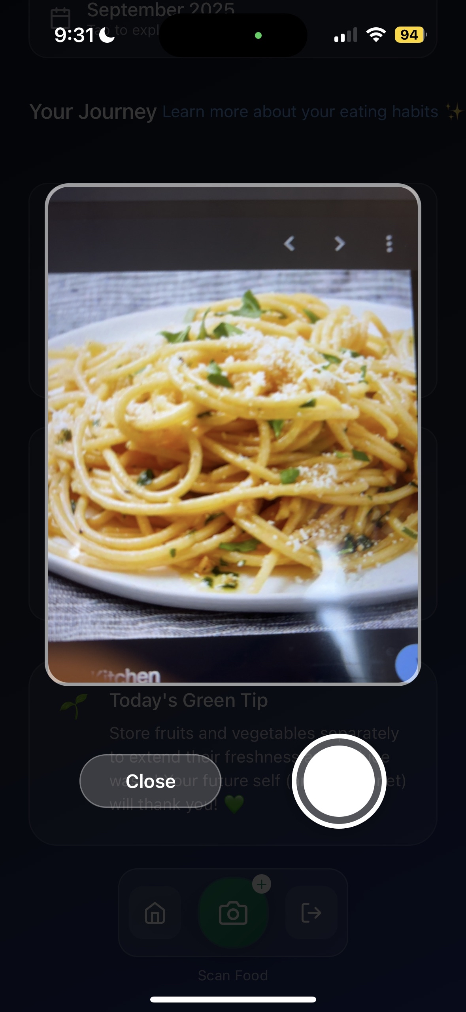
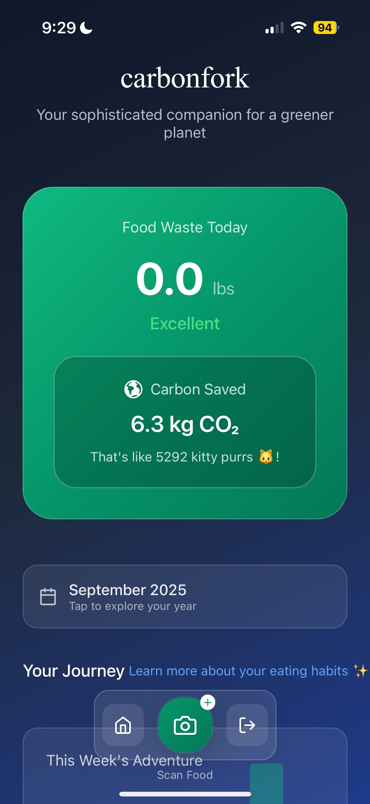
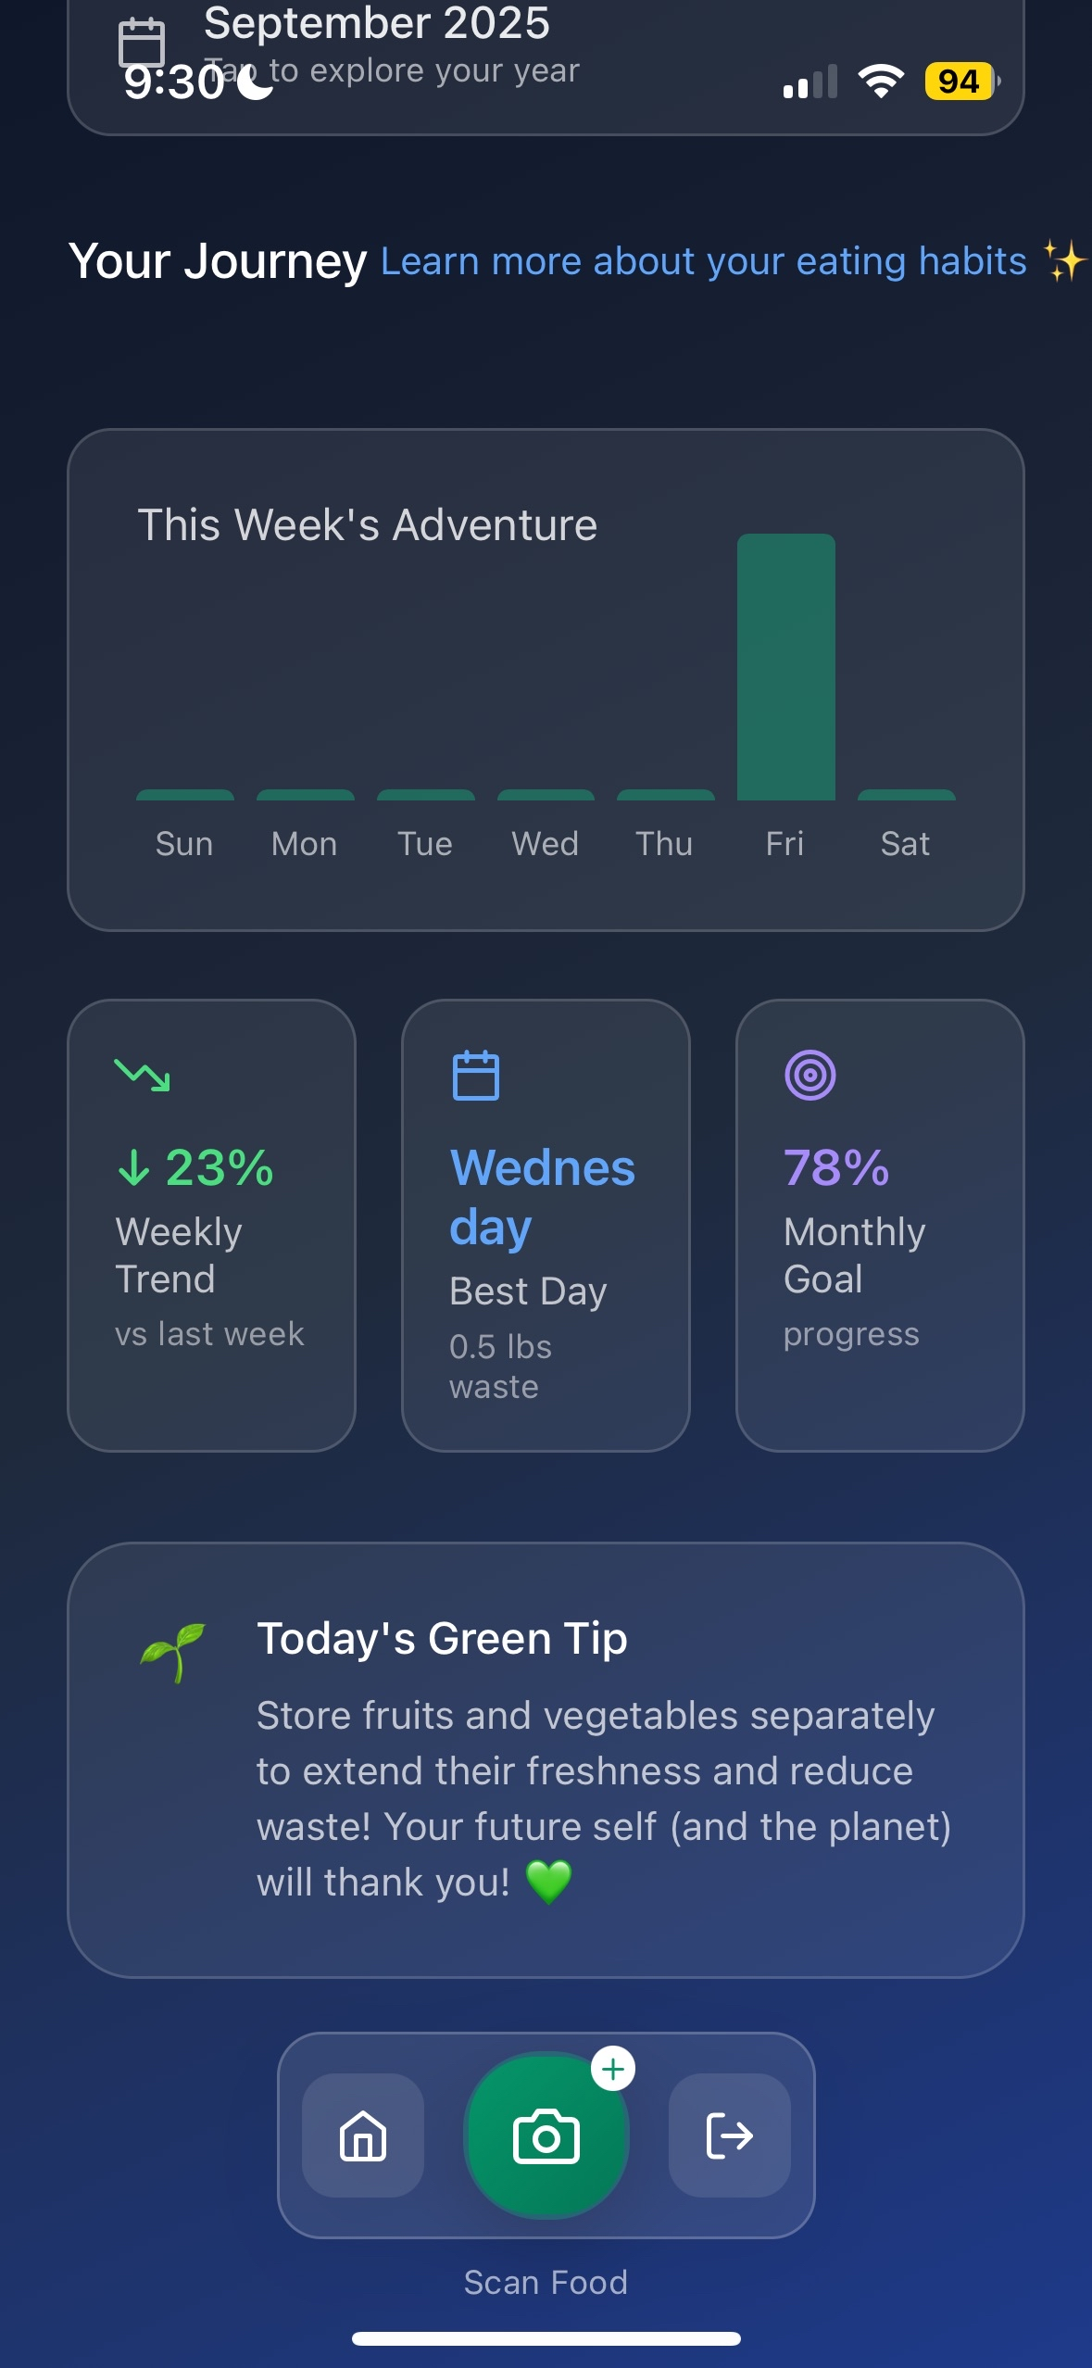
Carbon Fork

Slide 5
What it does
Food waste tracker
Creates awareness, thought, action, and change.
Calculates the carbon emissions that have been lost due to your wasted food
Uses computer vision to make user experience seamless

Slide 6
How it works
User uploads image
Computer vision and analysis
Identify food and its carbon emission values
Estimate weight
Calculate carbon emissions from dataset
Return the carbon used to the user

Slide 7






Tech Stack

Slide 8
Challenges
React native ended up being way more difficult than we initially thought.
We though working with React Native would be easy and similar to working with React,
However it ended up being quite different, and figuring out the differences and weeding
through errors proved a challenge.
Google Gemini pro vision is what we used to estimate the weight of the food on the plate.
Sadly, Gemini initially proved to be very inaccurate at this task, which was disappointing because
There isn’t anything we can do about this algorithmically. Instead, we had to come up with a solution
to somehow make the measurements more accurate. This proved a massive challenge and took many hours.
Flask is what we used for connected the front and backend, and we had lots of trouble transferring images over flask, giving us a 400 error every time.

Slide 9
Demo

